Slide 1
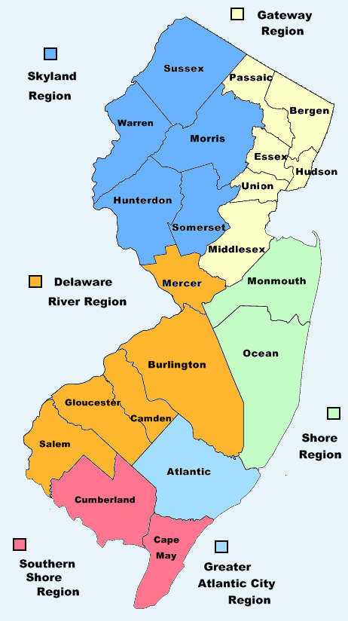
New Jersey Stroke Coordinator Consortium
Stroke Awareness Education For EMS

Slide 2

Don’t Just Act F.A.S.T…….
B.E.F.A.S.T.
Remember Time Lost
is Brain Lost!!

Slide 3
